Slide 1

Decoding Olympic Success A Data-Driven Strategy for the National Olympic Committee Prepared by: Angkon Biswas Date: July 10, 2025

Slide 2

Table of Contents
The Challenge & The Goal
Initial Questions & Hypotheses
Data Preparation & EDA
Testing the Core Hypotheses
Deeper Insights: Custom Metrics
The Core Insight: A Strategic Choice
Recommendations & Action Plan
Conclusion & Next Steps

Slide 3
The Challenge & The Goal
The Client: A National Olympic Committee of a Developing Nation (NOC-DN).
The Challenge: Competing on a global stage with a budget that is a fraction of that of powerhouse nations.
The Goal: To move beyond anecdotal evidence and provide a clear, data-backed strategy to optimize investment for a higher return in the form of Olympic medals.
The Dataset: A rich dataset of historical Olympic data (1896-2016), enriched with World Bank economic and demographic data.

Slide 4
Initial Questions & Hypotheses
Initial Questions:
Which nations are the historical powerhouses?
How have the physical characteristics of athletes evolved?
Are some sports more strategically important for medal counts?
Initial Hypotheses
H1: Larger, wealthier countries will dominate, but smaller nations can succeed in niche sports.
H2: The average age of medalists will vary significantly by sport type and over time.
H3: Athletic excellence will globalize, with a shift in medal distribution towards emerging nations.

Slide 5
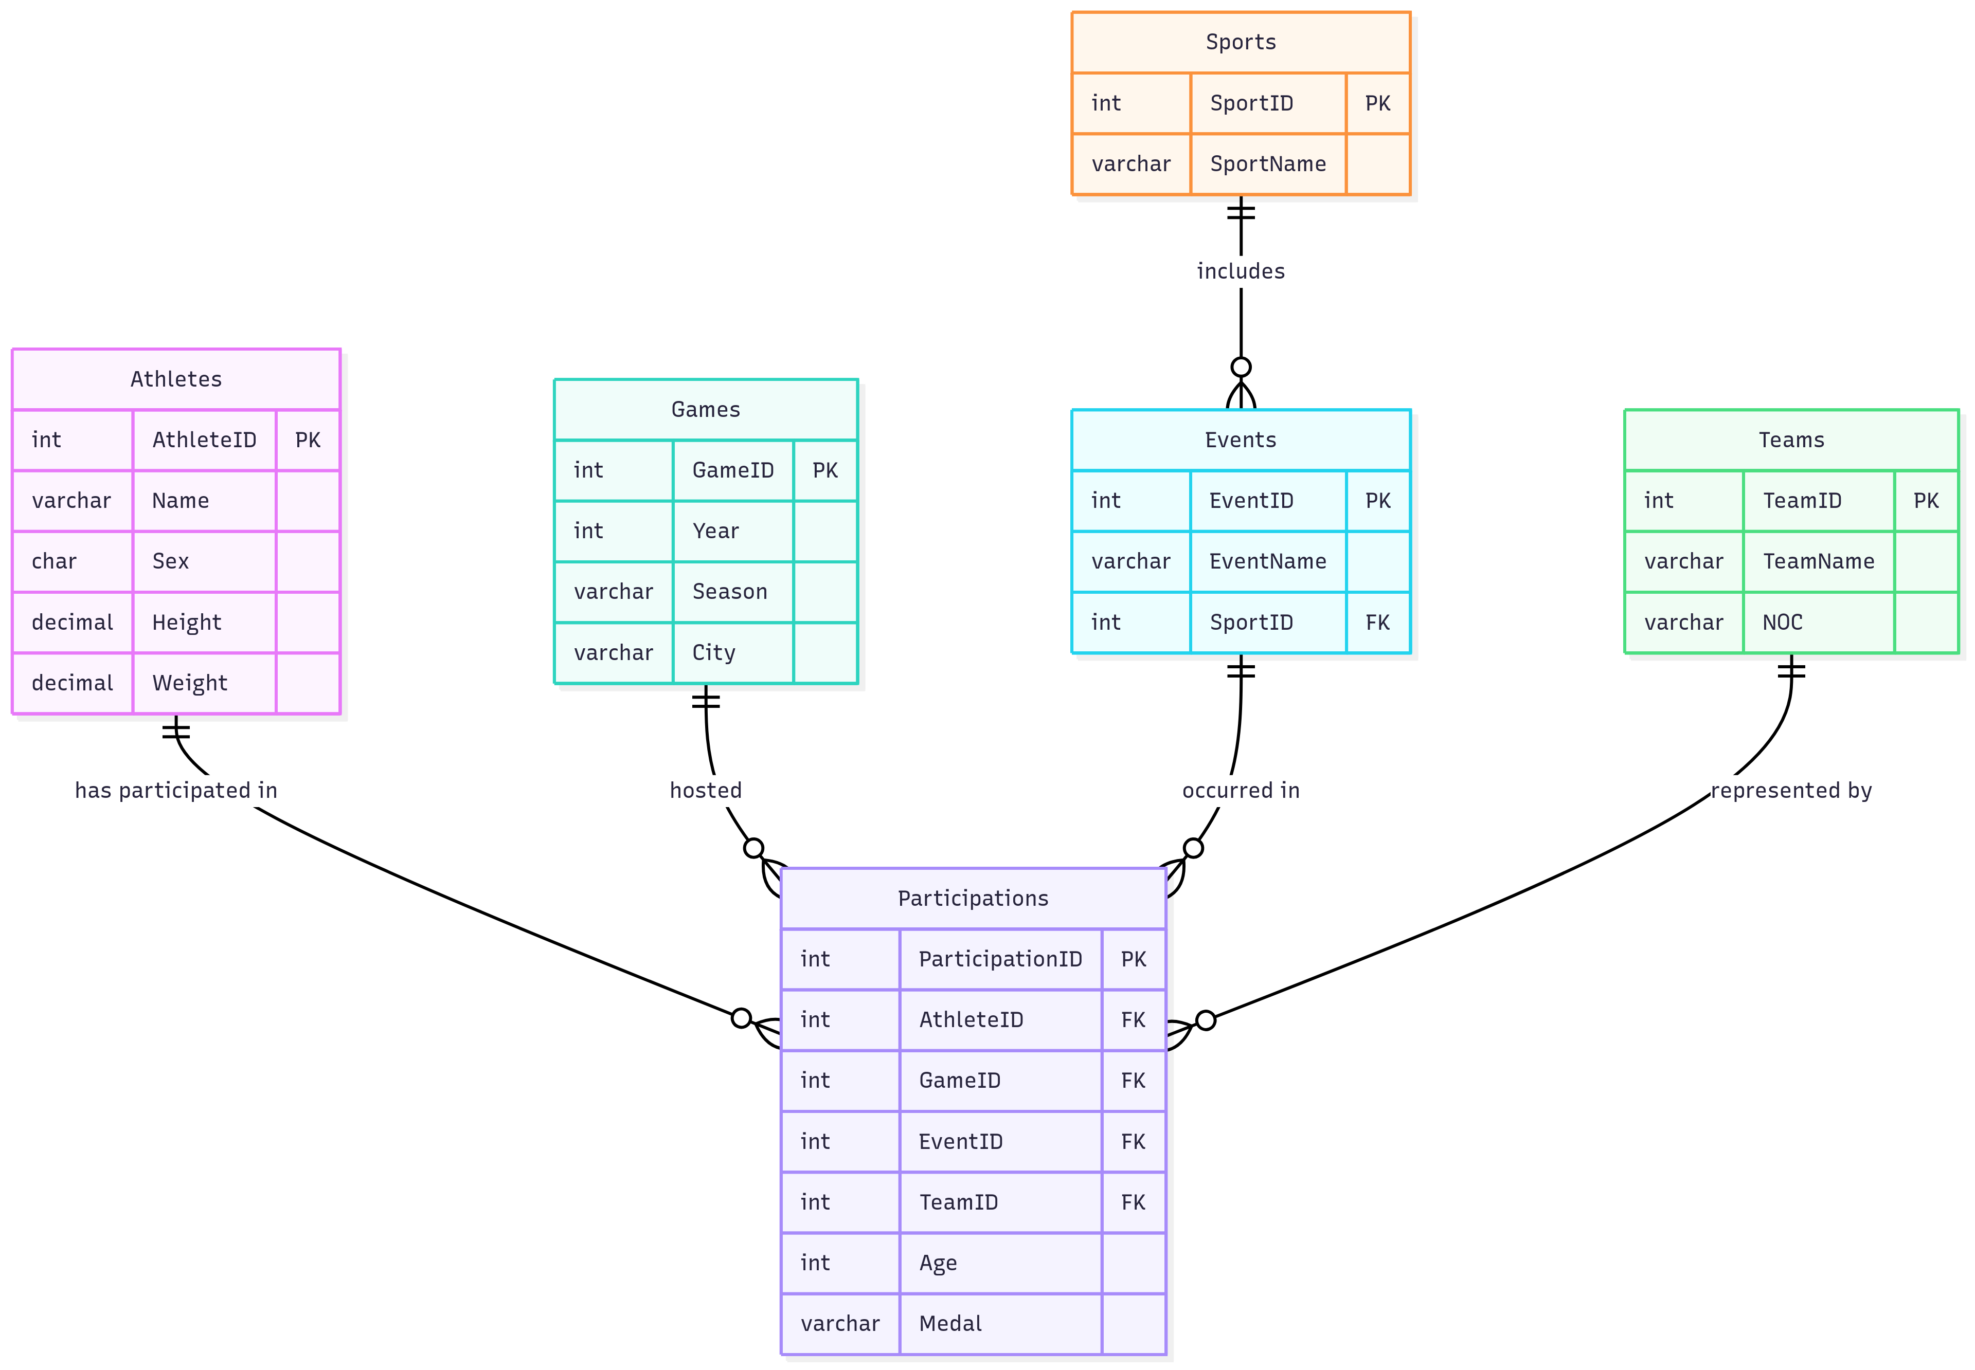
Data Preparation & Cleaning
Data Preparation & Cleaning
Data Cleaning: A critical first step to ensure the integrity of our analysis.
Null Value Imputation: Handled missing values for Age, Height, and Weight by imputing column averages, preserving valuable records for analysis.
Duplicate Removal: Identified and removed 1,385 fully duplicate rows to prevent overcounting.
Database Design:
The initial flat file was normalized into a relational database schema (ERD).
This improved data integrity, reduced redundancy, and enabled more efficient and complex querying.

Slide 6

Exploratory Data Analysis (EDA) - Key Discoveries
The "No Medal" Phenomenon: The sheer volume of participation that did not result in a medal (over 229,000) was a critical "Aha!" moment.
Insight: Success isn't just about winning; understanding the characteristics of all participants is key.
Clear Dominance: The top 10 medal-winning nations account for a disproportionately large share of all medals won.
Insight: This confirmed that a few nations have historically dominated, setting the stage for deeper analysis into how.
Team vs. NOC Anomaly: The number of unique "Team" names (1,184) was far greater than unique countries (230).
Insight: This highlighted the importance of using the NOC column for accurate country-level analysis.

Slide 7
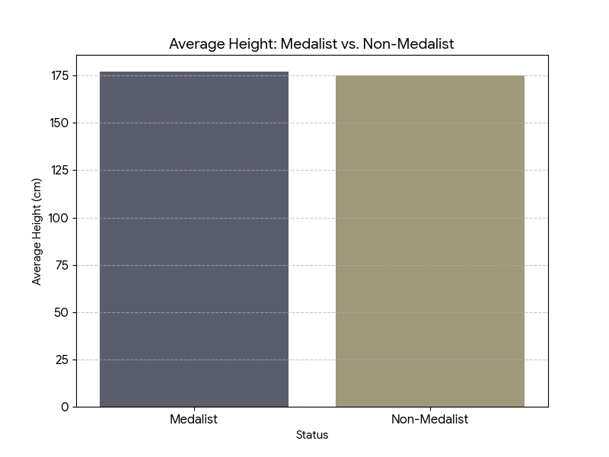
Testing the Core Hypotheses Hypothesis 1: The Physique of a Champion
Hypothesis: Taller athletes are more likely to win medals.
Result: CONFIRMED.
Finding: Medalists are, on average, 2.4 cm taller than non-medalists (178.8 cm vs 176.4 cm). Physical attributes provide a discernible, aggregate advantage.

Slide 8
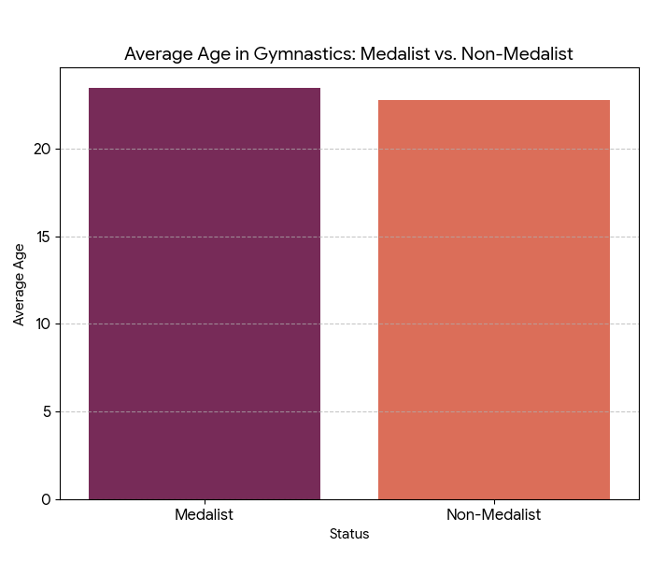
Hypothesis 2: The Age Paradox in Gymnastics
Hypothesis: Younger gymnasts are more likely to win medals.
Result: DISPROVED.
Finding: The median age of medal-winning gymnasts (23.46) is slightly older than non-medalists (22.78). This suggests competitive experience and mental fortitude are critical differentiators at the elite level.

Slide 9
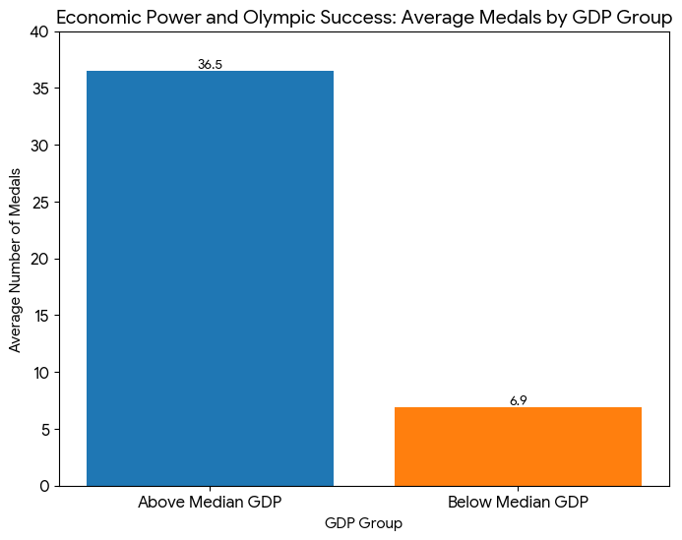
Hypothesis 3:Economic Power and the Podium
Hypothesis: A country's GDP has a strong positive correlation with its medal count.
Result: CONFIRMED.
Finding: In 2016, nations with an above-median GDP won an average of 36.5 medals, compared to just 6.9 medals for those below the median. GDP is a powerful predictor of success.

Slide 10
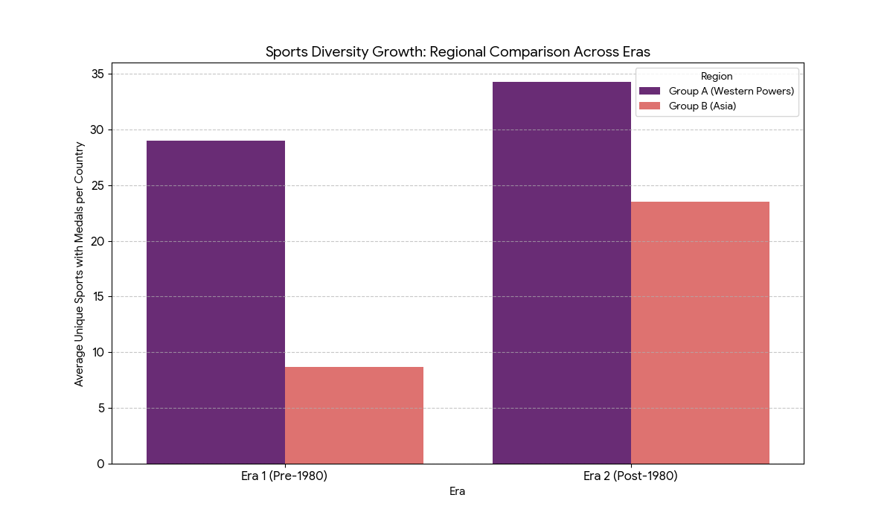
Hypothesis 4: The Globalization of Sport
Hypothesis: Emerging regions are diversifying their medal wins across more sports.
Result: CONFIRMED.
Finding: While Western powers grew from winning medals in 11.4 to 16.6 unique sports (pre-1980 vs post-1980), Asian nations saw a much larger leap from 6.3 to 14.1, narrowing the gap significantly.

Slide 11
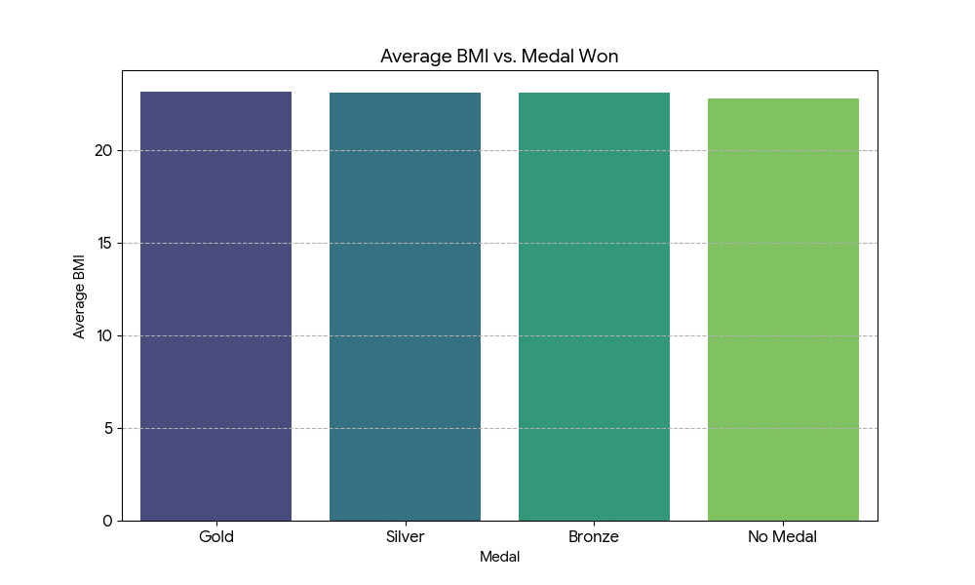
Deeper Insights: Creating Custom Metrics
The hypothesis results were insightful, but to create an actionable strategy, we needed to move beyond them. We developed three custom metrics to measure performance in a more nuanced way.
Metric 1: Body Mass Index (BMI)
Why: To move beyond simple height/weight and understand the role of an athlete's overall build.
Discovery: The average BMI of medalists varies significantly by sport and season, confirming that different athletic disciplines require distinct physical profiles. This allows for more targeted talent identification.

Slide 12
More Metrics Created
Metric 2: Medal Conversion Rate (MCR)
Formula: (Total Medals Won / Total Participations) * 100
Why: Simply counting total medals favors larger countries. MCR measures efficiency—how effective a country is at turning an appearance into a podium finish.
Discovery: This was the core strategic insight. Many smaller nations have a significantly higher MCR than larger ones, proving that a smaller, focused team can be more effective on a per-athlete basis.
Metric 3: Athlete Versatility Index (AVI)
Formula: COUNT (DISTINCT Sport) for each athlete.
Why: To identify and celebrate the rare athletes who compete across multiple disciplines.
Discovery: High AVI athletes are historical anomalies, almost exclusively from the early-to-mid 20th century. This reinforces that the modern path to victory is through hyper-specialization.

Slide 13

The Core Insight: Two Paths to the Podium
Path 1: Resource Dominance
Leverage a massive GDP to fund a wide array of sports programs.
Compete everywhere, win through sheer volume.
Not viable for the NOC-DN.
Path 2: Strategic Specialization
Focus limited resources on a few key disciplines.
Maximize the Medal Conversion Rate (MCR) to become highly efficient.
Achieve success that outpaces economic standing.
This is the recommended path.

Slide 14
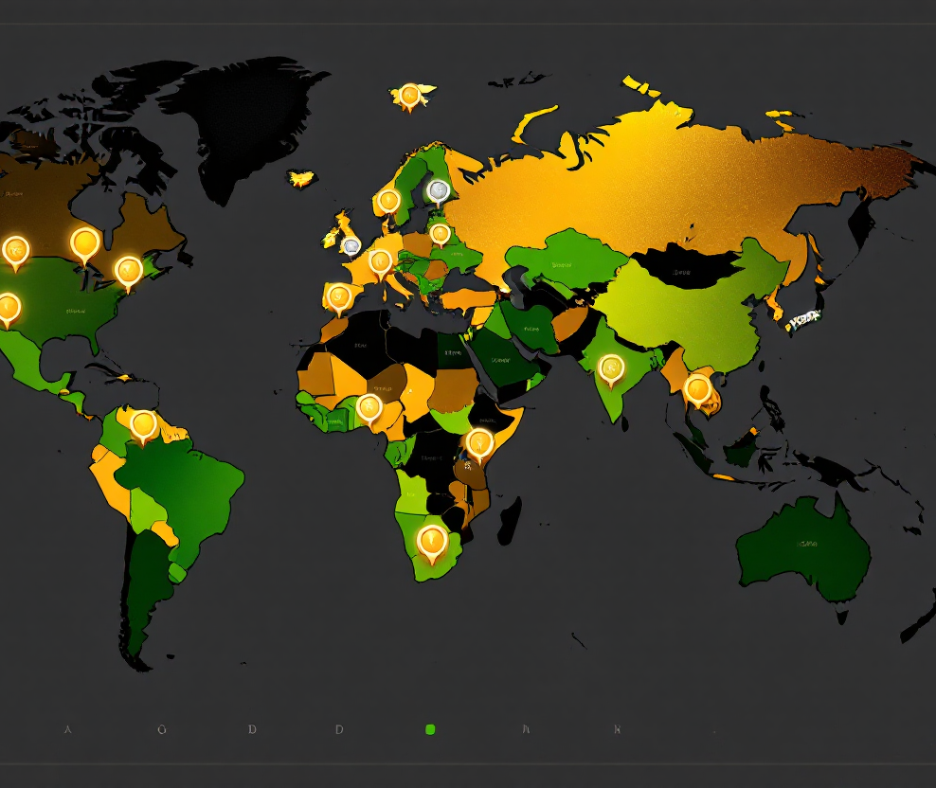
Strategic Recommendations
1. Adopt a "Strategic Specialization" Model: Formally abandon the generalist approach. The nation must become a specialist. Identify and commit to 3-5 high-opportunity sports.
2. Conduct a Cost-Benefit Analysis: Select the focus sports based on data:
Low infrastructure and training costs.
A high number of medal events within the discipline.
Potential for natural regional or genetic propensity.
3. Track National Performance Metrics: Use MCR and a custom Medal-to-GDP Ratio (MGR) as core internal KPIs to guide investment and measure program success objectively.

Slide 15
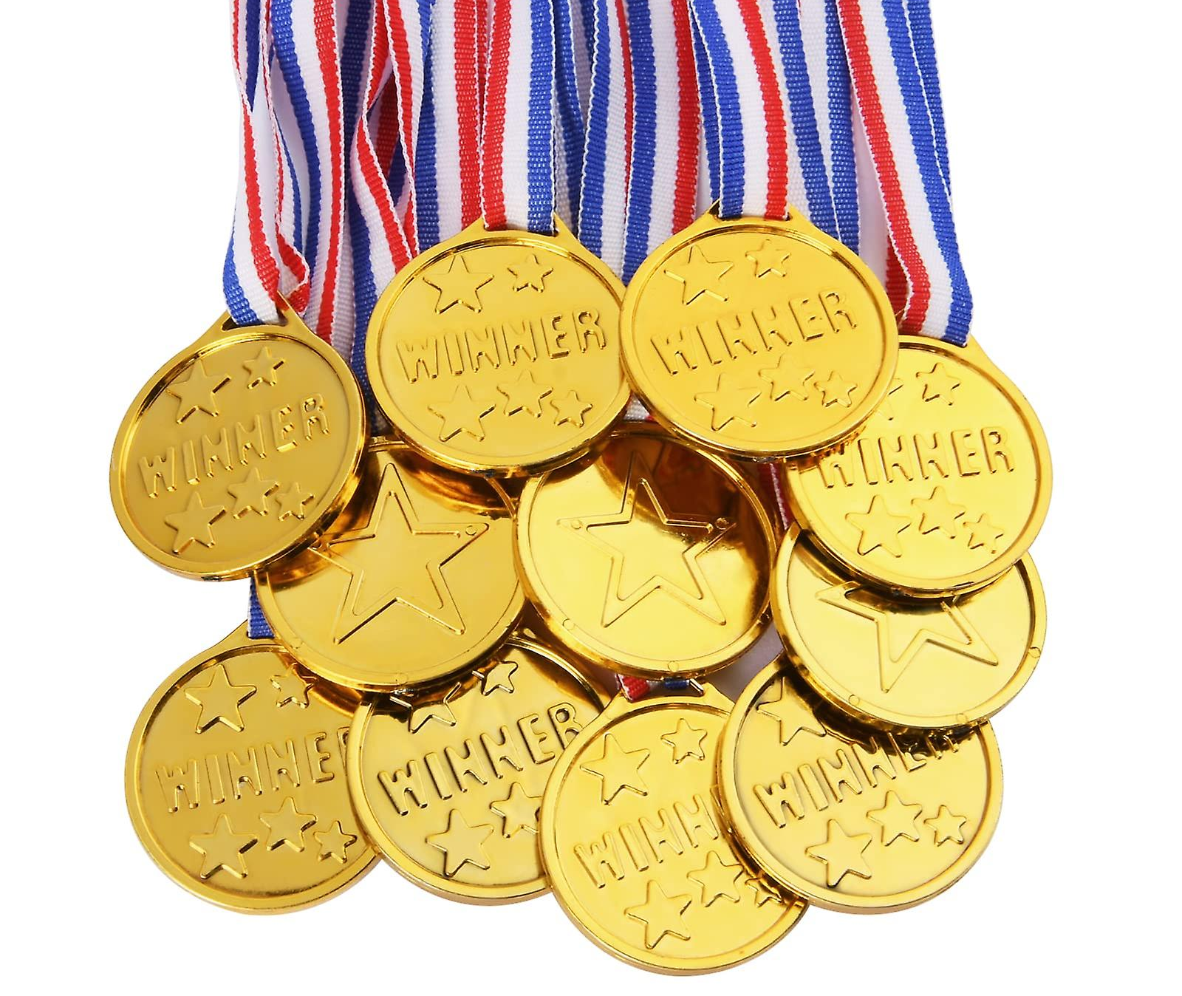
Proposed Next Steps: A 4-Year Plan
Phase 1 (3 Months): Sport Identification
Commission a task force to execute the cost-benefit analysis and present a data-driven shortlist of 5-7 potential focus sports.
Phase 2 (1 Year): Pilot Program
Launch intensive, heavily funded pilot programs for the top 3 sports from the shortlist. Focus on elite talent identification and coaching.
Phase 3 (4-Year Cycle): Full Implementation
Based on pilot results, allocate the vast majority of the NOC-DN's budget to the top 2-3 performing programs with the explicit goal of winning medals at the next Olympic Games.

Slide 16
Conclusion & Q&A sessions
Conclusion: While economic power is a major factor in the Olympics, it is not destiny. A data-driven strategy of focused, efficient specialization offers a clear and viable path for developing nations to compete and achieve success on the world stage.
Thank You
Questions?

Slide 17
Thank you
Angkon Biswas
angkonbiswas1993@gmail.com

